Slide 1
CMS Division of Tribal Affairs
Centers for Medicare & Medicaid Services
NIHB Webinar: Health Insurance Enrollment during COVID-19 PHE

Slide 2
Role of CMS Tribal Affairs
CMS Division of Tribal Affairs (DTA) is located in Baltimore within the Children & Adults Health Programs Group (CAHPG), under the Center for Medicaid & CHIP Services (CMCS).
DTA serves as the point of contact on Indian health issues for the agency and works in collaboration with Native American Contacts (NACs) to provide technical assistance to our Tribal and Federal partners.
Notes:
Our office, the Division of Tribal Affairs or DTA, is part of CMS. Specifically, we’re part of the Children & Adults Health Programs Group, abbreviated as “CAP”, within the Center for Medicaid and CHIP Services, known as CMCS.
A list of DTA staff and Native American Contacts or NACs are posted on our website.
Even though we’re located within Medicaid, we still work on all tribal issues that come up at CMS. We work closely with our partners in:
Medicare
Survey and Certification
The Marketplace
Data and Information Technology offices
The Office of Minority Health
and other offices.

Slide 3
Background and History
In 1976, Congress authorized IHS and Tribal hospitals and clinics to receive reimbursement for services provided to Medicare and Medicaid patients.
The authority to bill Medicare and Medicaid is unique to any other federal health program.
VA and DOD do not have this authority.
IHS publishes its reimbursement rates in the Federal Register on an annual basis, often called the All Inclusive Rate (AIR).
Notes:
This slide shows some of the history of Indian health and CMS programs. We want to highlight that the ability for ITUs to bill CMS is unique. This was intended to increase funding streams from Medicare and Medicaid for Indian health care programs and not to offset IHS funding.
The ability to bill CMS has increased reimbursements to the Indian health system to over 1 billion dollars a year. Reimbursements increase as more people enroll in the Health Insurance, Medicaid, Children’s Health Insurance Program (CHIP), and Medicare, bringing more funding into the Indian health system to meet accreditation standards, buy necessary equipment like MRI machines, and recruit additional staff.

Slide 4
Fact Sheets and Brochures
Brochures with information about coverage and Indian health facilities in your State.
Notes:
The Division of Tribal Affairs develops lots of fact sheets and brochures. These are examples of our latest series of brochures, which have information about coverage and Indian health facilities in your state.
Several years ago we held focus groups to test materials and found that utilizing graphics and pictures of tribal beneficiaries or communities increased the likelihood of the material being picked up and used. Our materials are developed to be culturally appropriate and utilized in tribal communities.
All of our materials are available for download on our website or to order from our warehouse.

Slide 5
Tribal Calendar
Notes:
We recently developed a new 18th month calendar that covers July 2020 to December 2021.
This calendar features health information, website links, and other helpful tips to improve your overall health.
The information in the calendar is intended to assist tribal families in taking better control of their health, including enrollment in health coverage through Medicare, Medicaid, CHIP, and the Health Insurance Marketplace.
The calendar is available to order through our website.

Slide 6
Monthly drop-in “news ads” and Radio Clips
Notes:
DTA also produces monthly Public Service Announcements (PSAs). For July, and in partnership with IHS, we developed this PSA for encouraging Tribal communities to utilize their local IHS, Tribal or Urban Indian clinics as a trusted source of health care.
The PSAs are produced as newspaper and radio ads and are published in tribal newspapers and played on tribal radio stations. The radio ads are recorded in ten Native languages and we also have an English version with local speakers that are aired along with the traditional language PSAs.

Slide 7
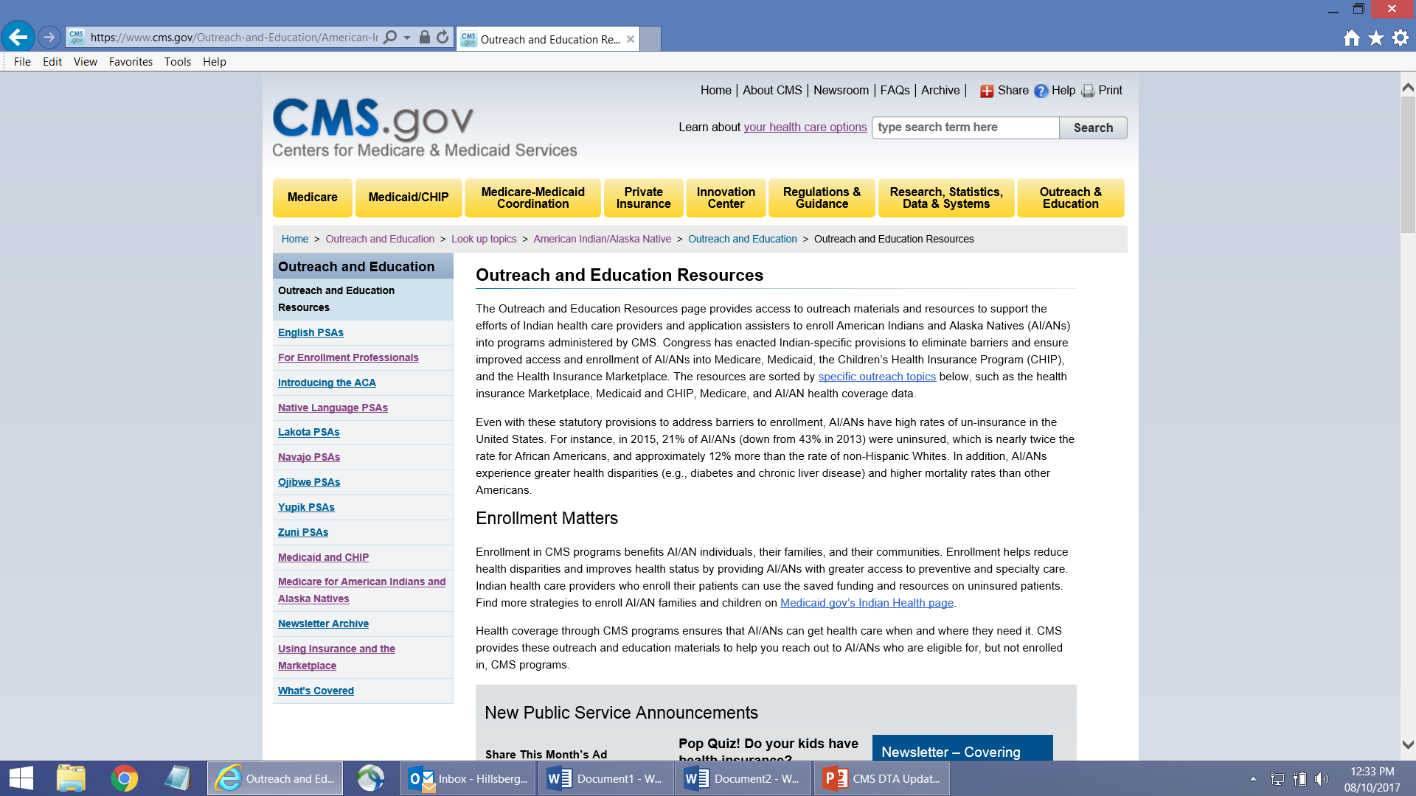
CMS AI/AN Website go.cms.gov/AIAN
Notes:
The CMS Division of Tribal Affairs has a great website. You can find it easily at go.cms.gov/AIAN Please use capital letters for “AIAN”
This is also where you may find the link to our You Tube videos that includes our PSAs, under the Outreach and Educations Resources tab.
We will put the link in chat and it is listed on our links slide.

Slide 8
Outreach and Education Newsletter
CLICK HERE
Notes:
You can sign up for the Outreach and Education newsletter by going to the Outreach and Education section of our website, scrolling down to “New Public Service Announcements” box, and clicking on the “Sign up” button.

Slide 9
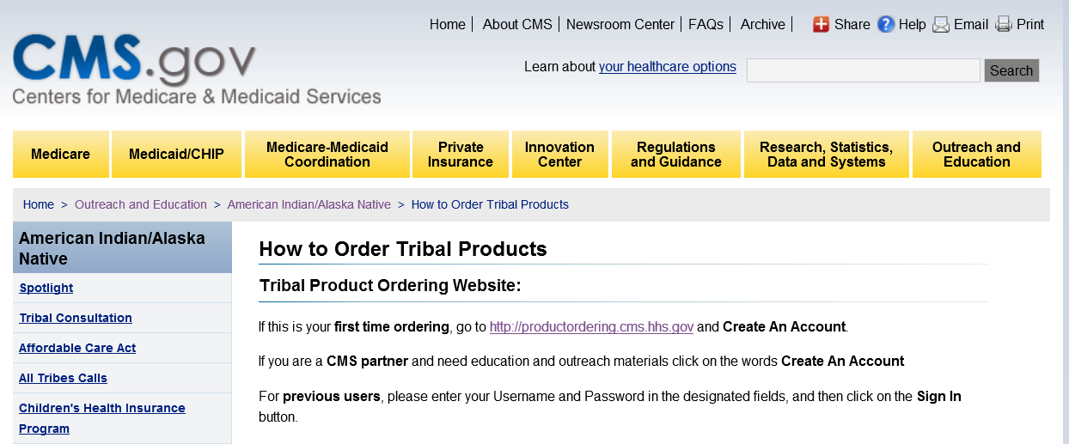
How to Order Tribal Products
If this is your first time ordering, visit: http://productordering.cms.hhs.gov
Notes:
I’ve mentioned several times that you can order materials from CMS. The materials are free and you can order as much as you want.
To get started, go to our products ordering page to create an account. Then, log on and order materials. You can do a search for tribal specific material and see a thumbnail of the product before you order it. The link is on this slide, in chat and on our links slide.
Please allow two weeks for your materials to arrive. You can also download materials from the Division of Tribal Affairs website at go.cms.gov/AIAN

Slide 10
CMS ITU Trainings and Webinars
CMS provides 16 face to face trainings
This year, CMS will convert its remaining 10 face to face trainings to virtual trainings.
To register or see a complete list of trainings visit www.regionalcmsitutrainings.com
CMS also provides 10 two (2) week medical coding boot camps.
CMS also holds webinars throughout the year
Notes:
CMS holds several face to face trainings every year. However, due to the public health emergency, the remaining 10 face to face trainings will be held virtually like this one. To register or to see updated information on our new virtual trainings, please visit the website on the slide.

Slide 11
Links: Websites and Webpages
Link to Products Ordering page: http://productordering.cms.hhs.gov
Link to Training website: www.regionalcmsitutrainings.com
Link to Archived Outreach and Education Webinars: http://go.cms.gov/All-Tribes-Calls

Slide 12
CMS Division of Tribal Affairs
For additional information:
DTA Website: go.cms.gov/AIAN
Questions: tribalaffairs@cms.hhs.gov
Notes:
Thanks for joining us today. Do you have any questions?

